Slide 1


Priya Gupta
Computer Science Graduate Student
(Jan 2020 – May 2021)
LinkedIn GitHub
Graduate School(MS): Stevens Institute of Technology (3.875/4)
Programming Language: JavaScript, TypeScript, Java, C#, SQL, Python
Front End: Node.js, Angular JS, React, Redis, GraphQL
Software Development: Agile, Waterfall
Work Experience : Bank Of America and Mercer Consulting (Marsh & McLennan Companies)

Slide 2
Technical Topic - Node.js
Node.js is a runtime environment for JavaScript that runs on the server. Node.js is an open source, cross-platform, and since its introduction in 2009, it got hugely popular and now plays a significant role in the web development.
Best Features:
1. Fast: One of the main selling points of Node.js is speed
2. Simple/ Extremely Modular: Node.js is simple and easy to maintain
3. Benefit of Fullstack JS: Node.js has been regarded as a full-stack JavaScript for serving both the client and the server-side applications
4. High Performance: This engine complies the JavaScript code directly into the machine code
5. Handles the Requests Simultaneously: providing the option of non-blocking I/O systems, it relatively helps you to process several requests concurrently
6. The Advantage of Caching: Node.js also provides the facility of caching single modules. Whenever there is any request for the first module, it gets cached in the application memory

Slide 3
Other Technology Stack
React: React will be used as our front-end framework to create a single page application and components that will be used on each page. Home Page, Music, Search, Sign In, Sign Up, Sign Out and complete frontend UI are implemented using React hook
Firebase Auth: Allow users to sign in via email/password, as well as Google or Facebook. Please note that Facebook sign in is in development mode. If you would like to login via Facebook, please provide us with your Facebook username and we will add you as a tester. Sign-In, Sign-up and password changing are implemented and handled using firebase authentication
Redis: Redis is used to cache api data on server
MongoDB: MongoDB is used for database purpose. We stored all tweets (posts) into mongoDB along with user’s information. The schema is implemented in simple manner. Each object holds information about user(name, profile picture), tweets , liked tweets and comments. Used timestamp to display recent tweets and comments at top
Express: Express is a minimal and flexible Node.js web application framework that provides a robust set of features for web applications. Used Node.js to route data and communicate between backend and frontend. With a myriad of HTTP utility methods and middleware, created a robust API

Slide 4
Independent Technology
Spotify API:
This project integrated Spotify API to use Spotify song data. The Spotify API are accessed using access token. Taken care of refreshing Access token periodically
The Spotify API are used to get data such as album, artist, playlist and tracks. It is also used to perform search queries
User recommended songs are also populated using API
Docker:
This will provide a containerization for the deployment environment along to dev in the same environment the project will be hosted on

Slide 5

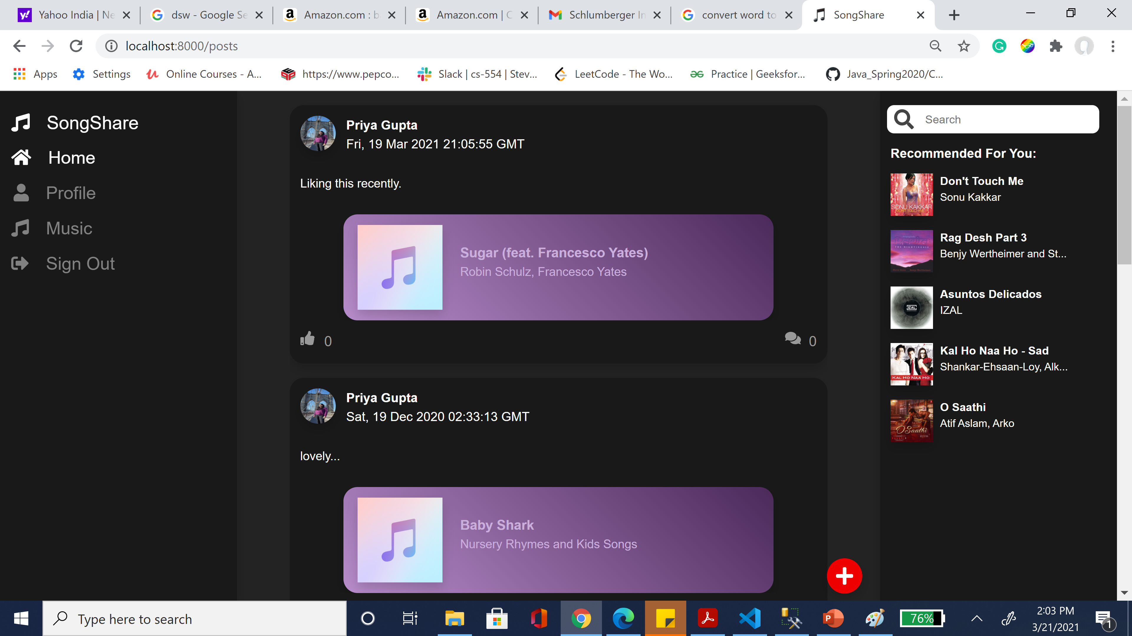
Spotify Twitter
This is my 2nd semester group project, which involves a team of 5 people including me.
Spotify Twitter is one stop for all music lovers. Just at one click listen and tweet your most loved song with your loved ones.
It provides amazing features to listen song and tweet at same time using one platform. Our project integrated one of the leading music app Spotify. So, just login with Spotify account and enjoy music while sharing with others. We took care of one’s music taste and provided feature where you can see recommendation.

Slide 6

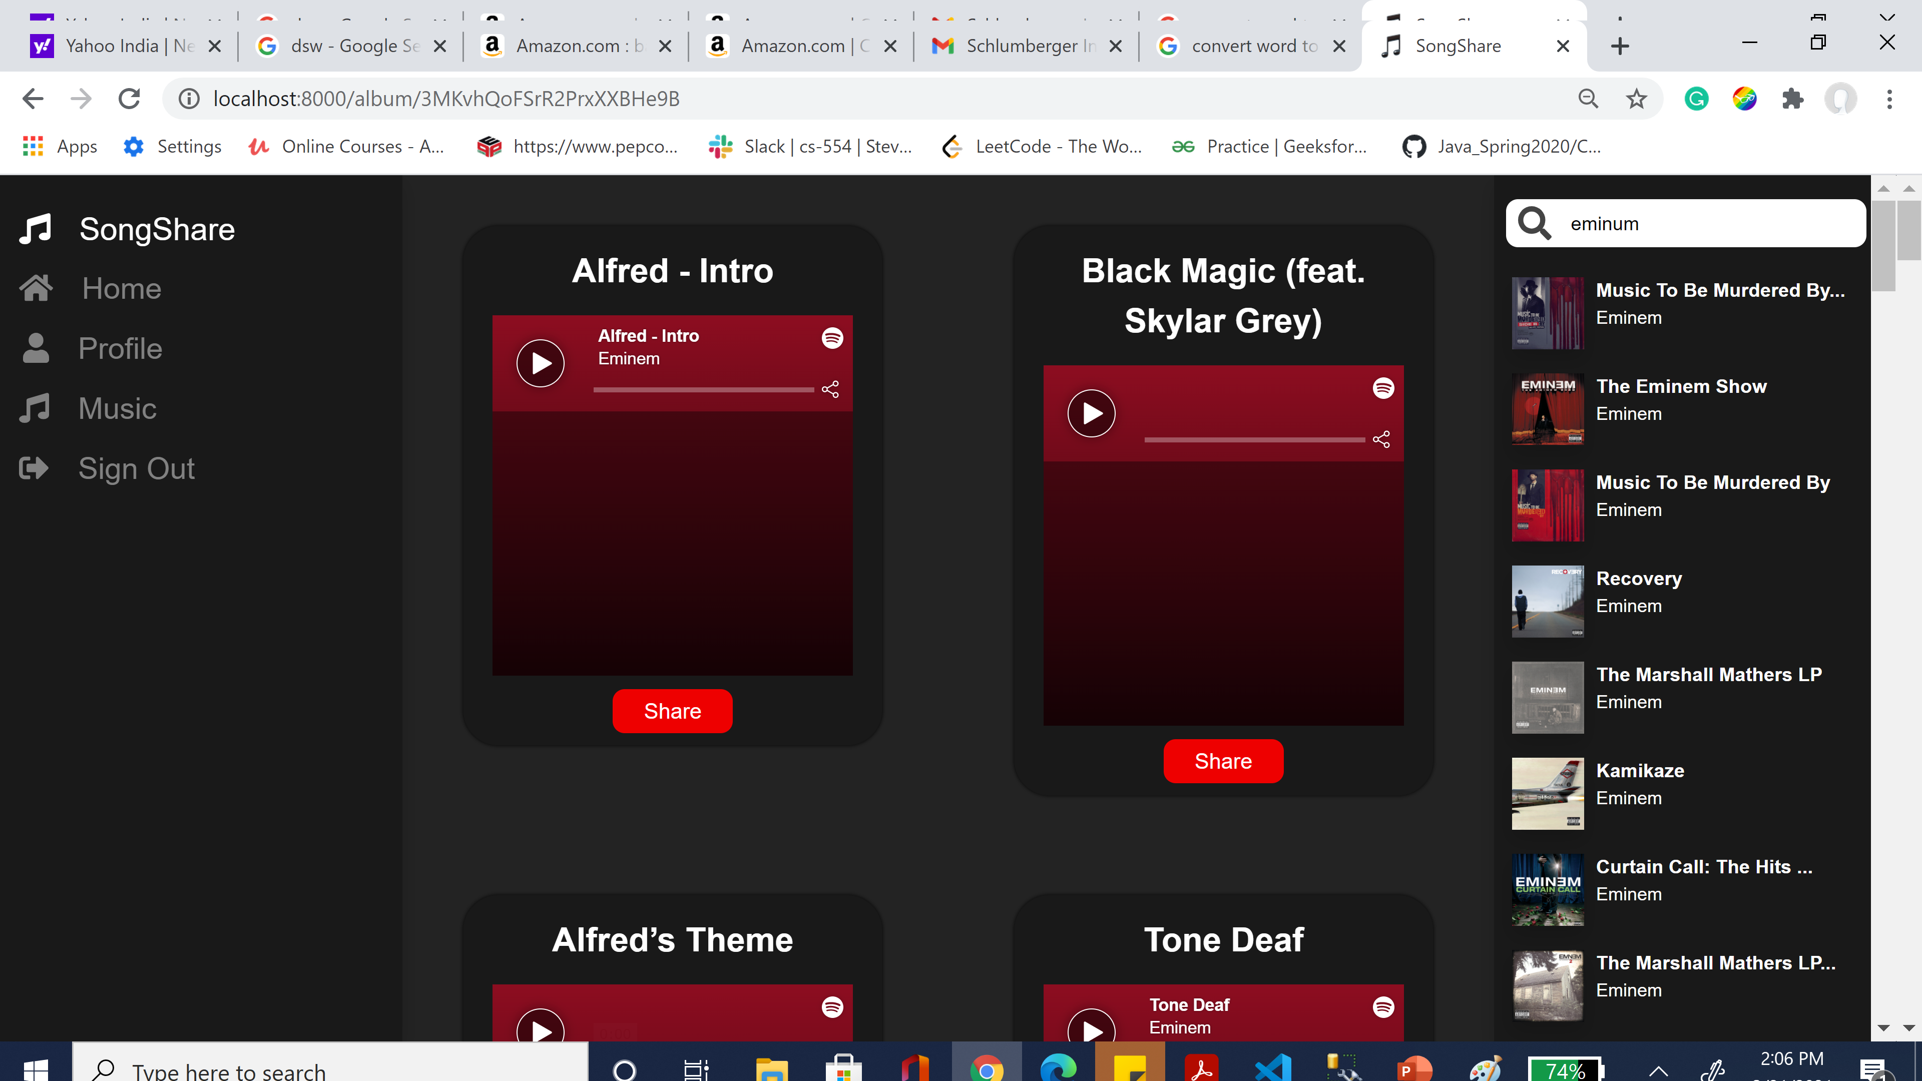
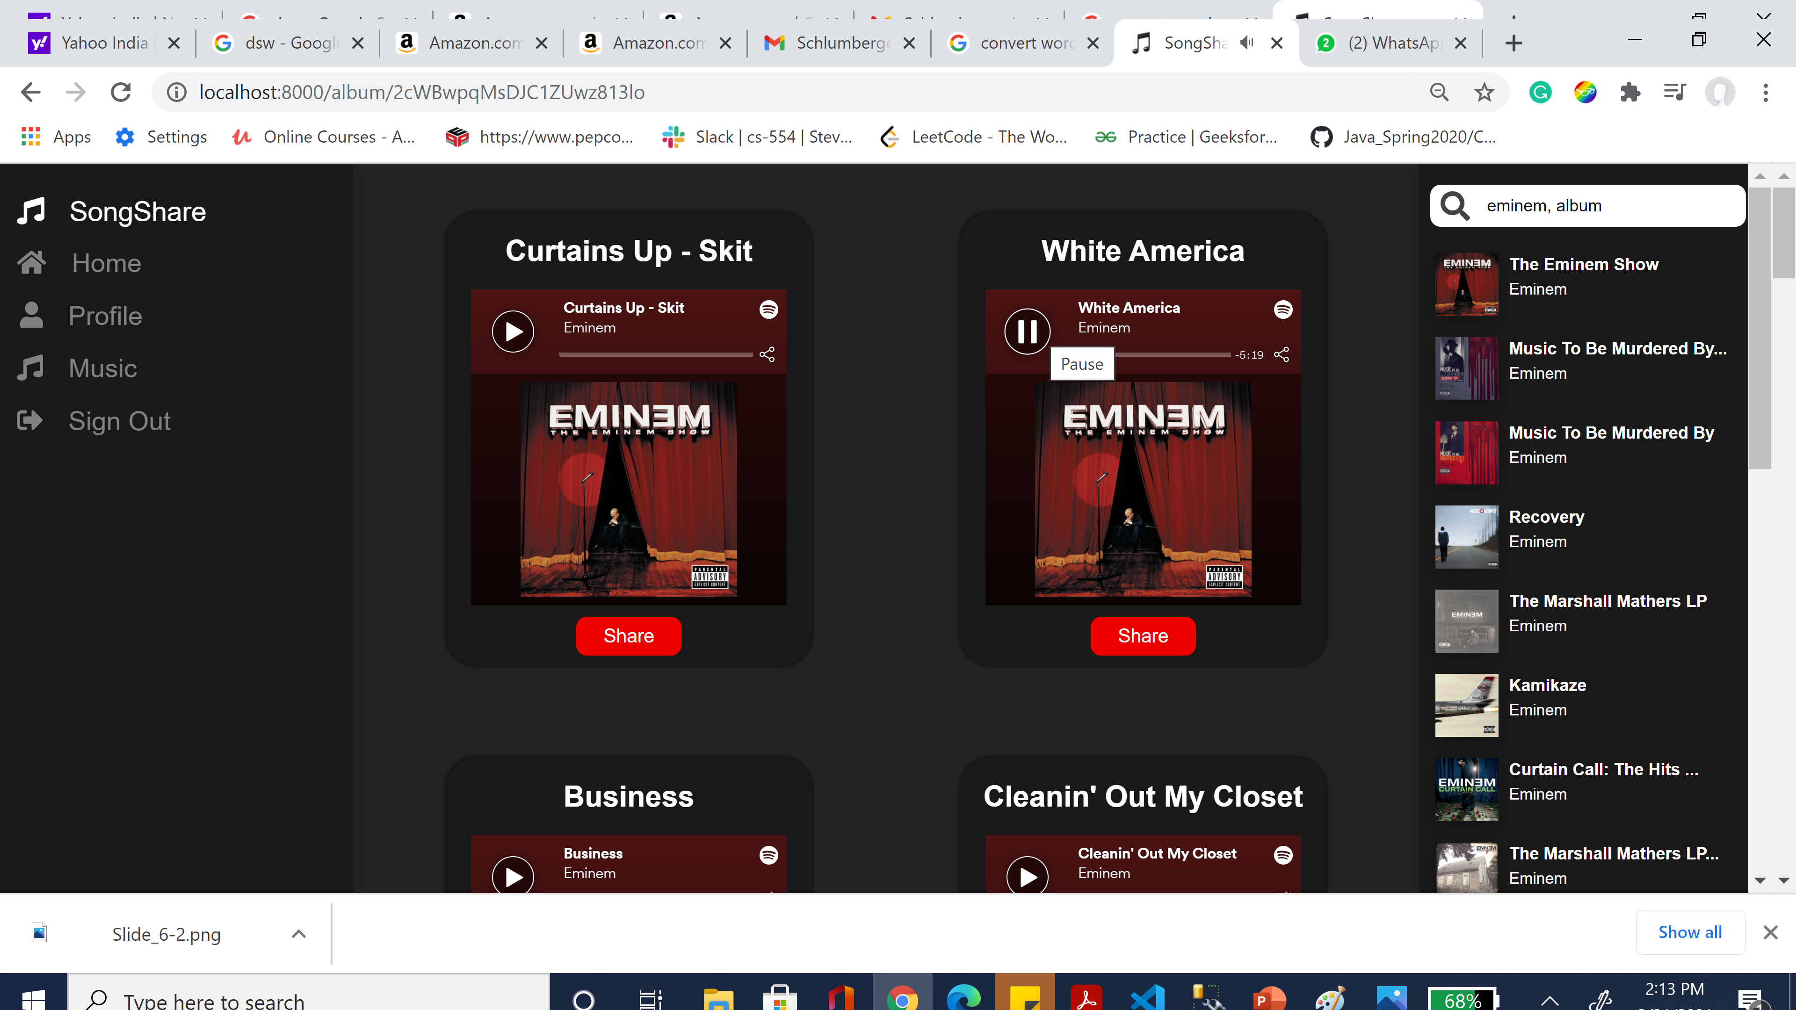
Spotify Twitter
Song Search
Play full song

Slide 7
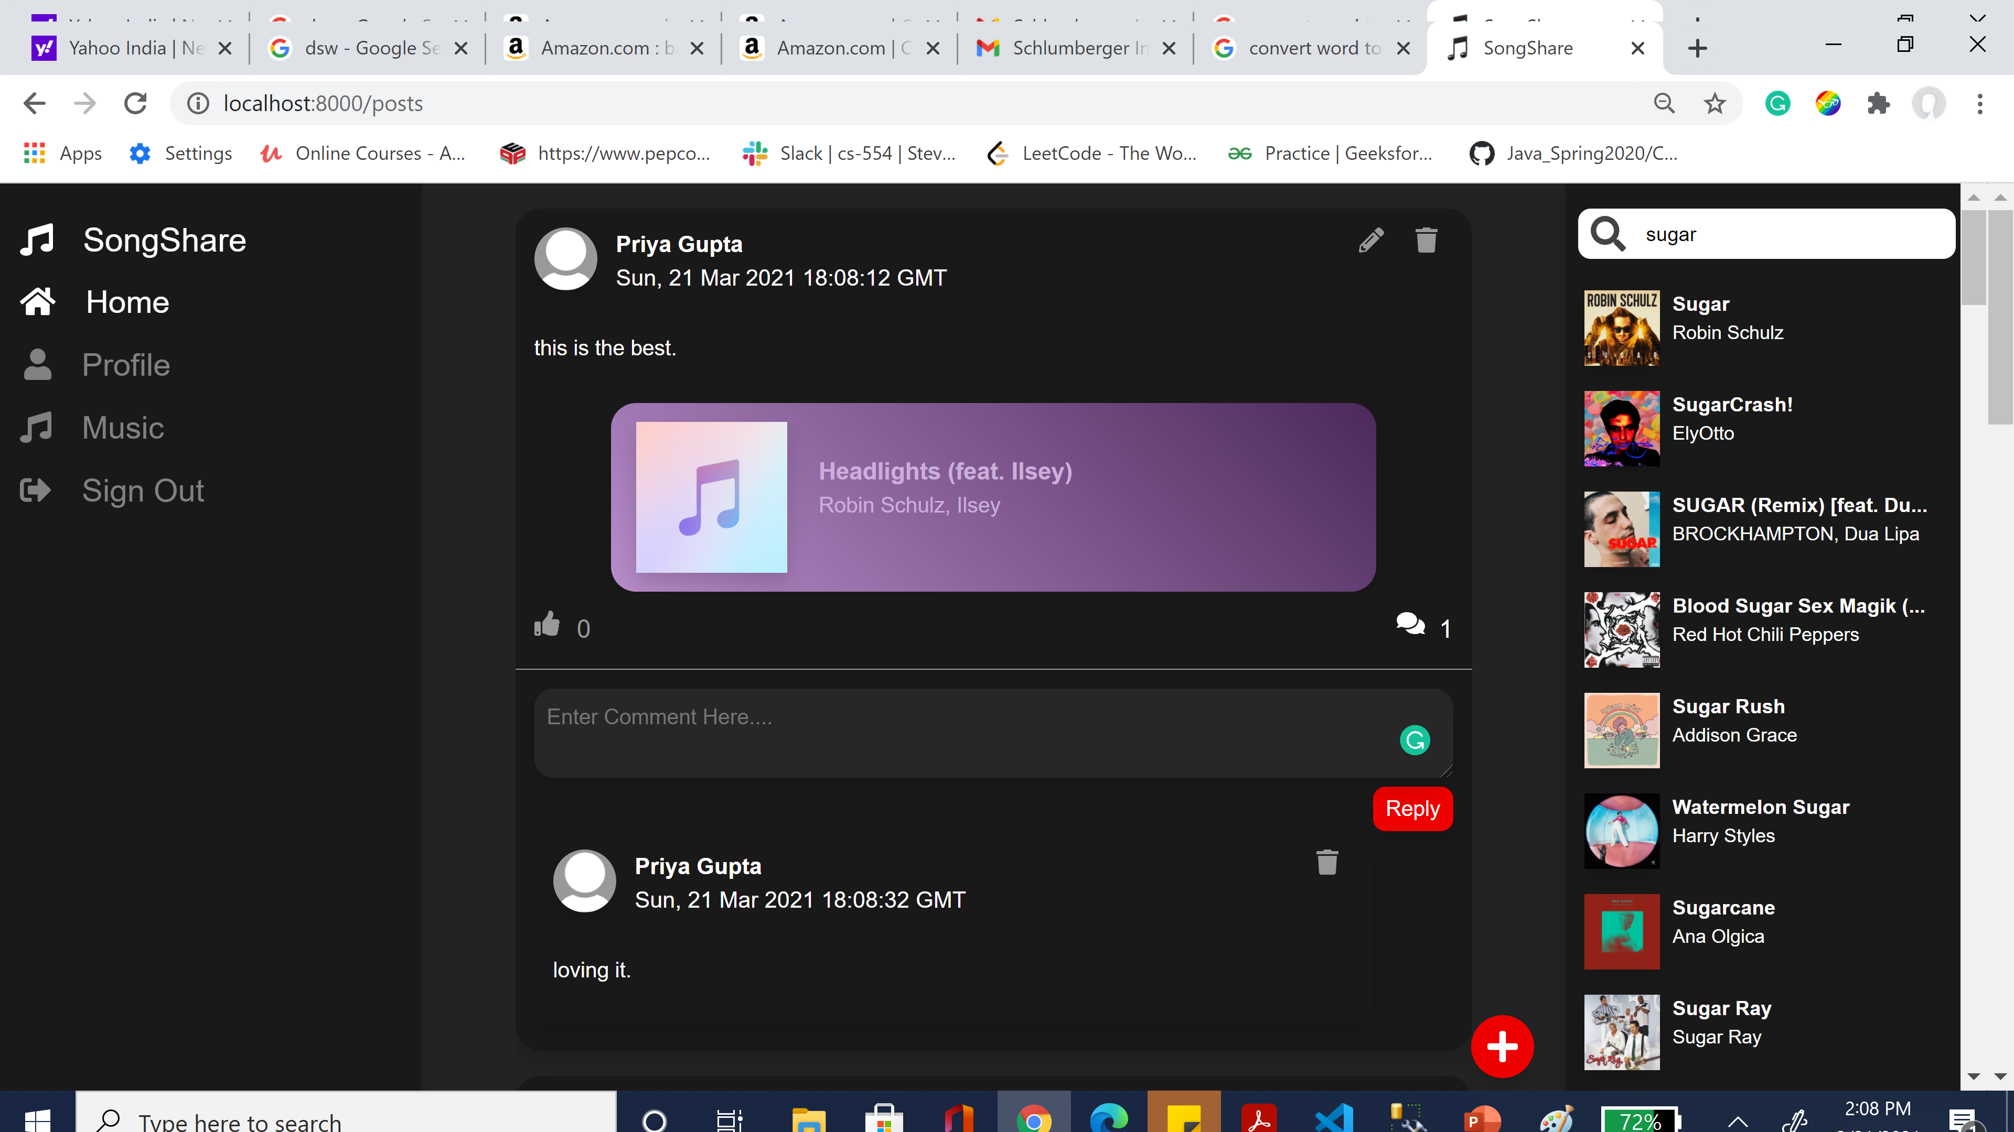
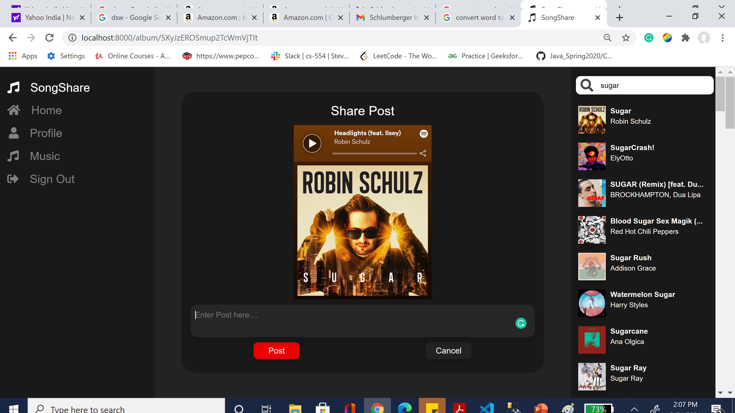
Spotify Twitter
Share Song
Post Like & Comment

Slide 8
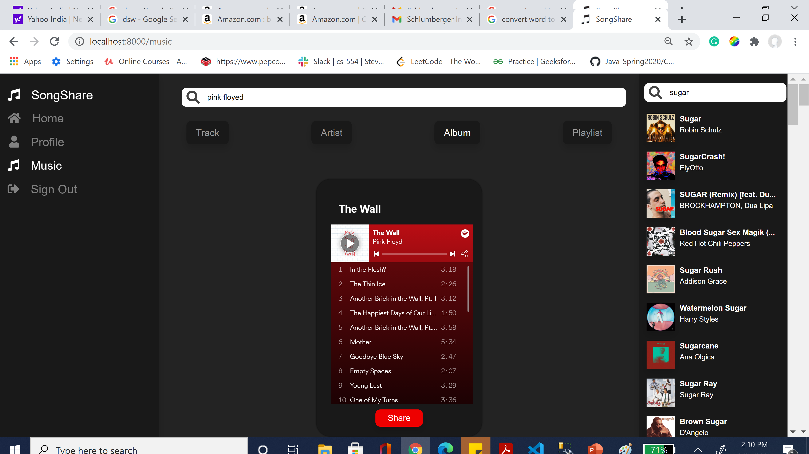
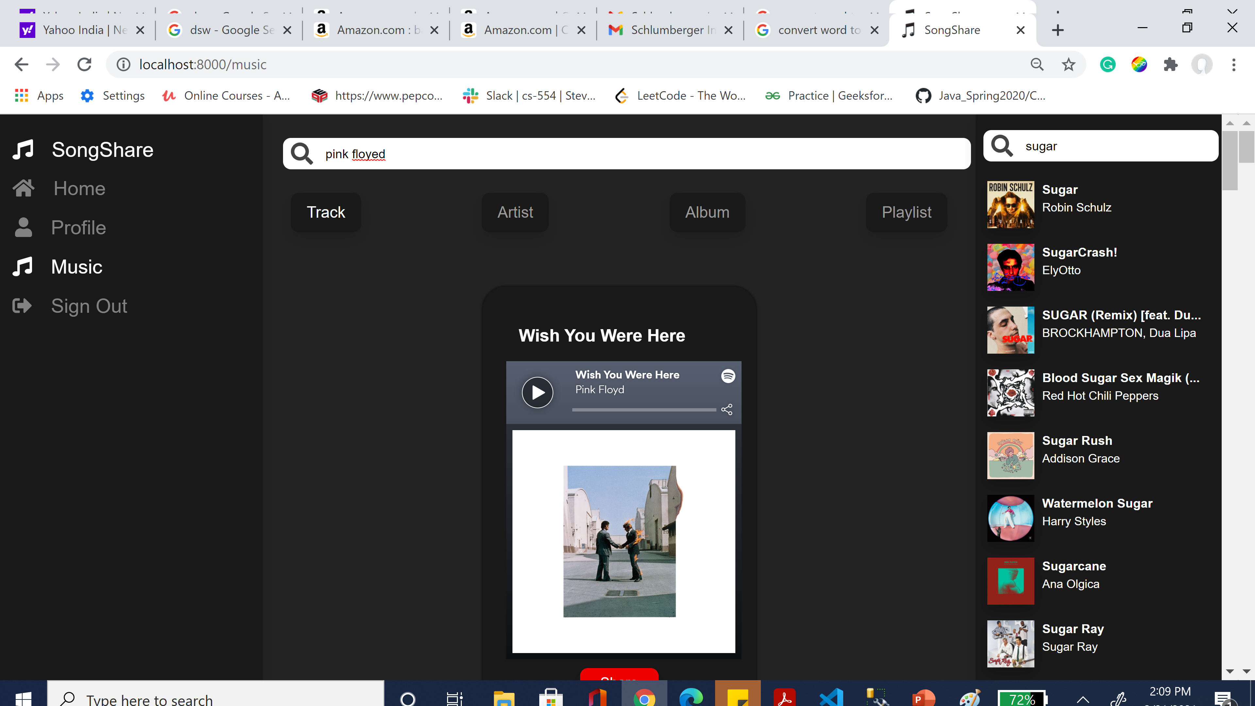
Spotify Twitter
Option to filter songs by Track, Artist, Album and Playlist

Slide 9
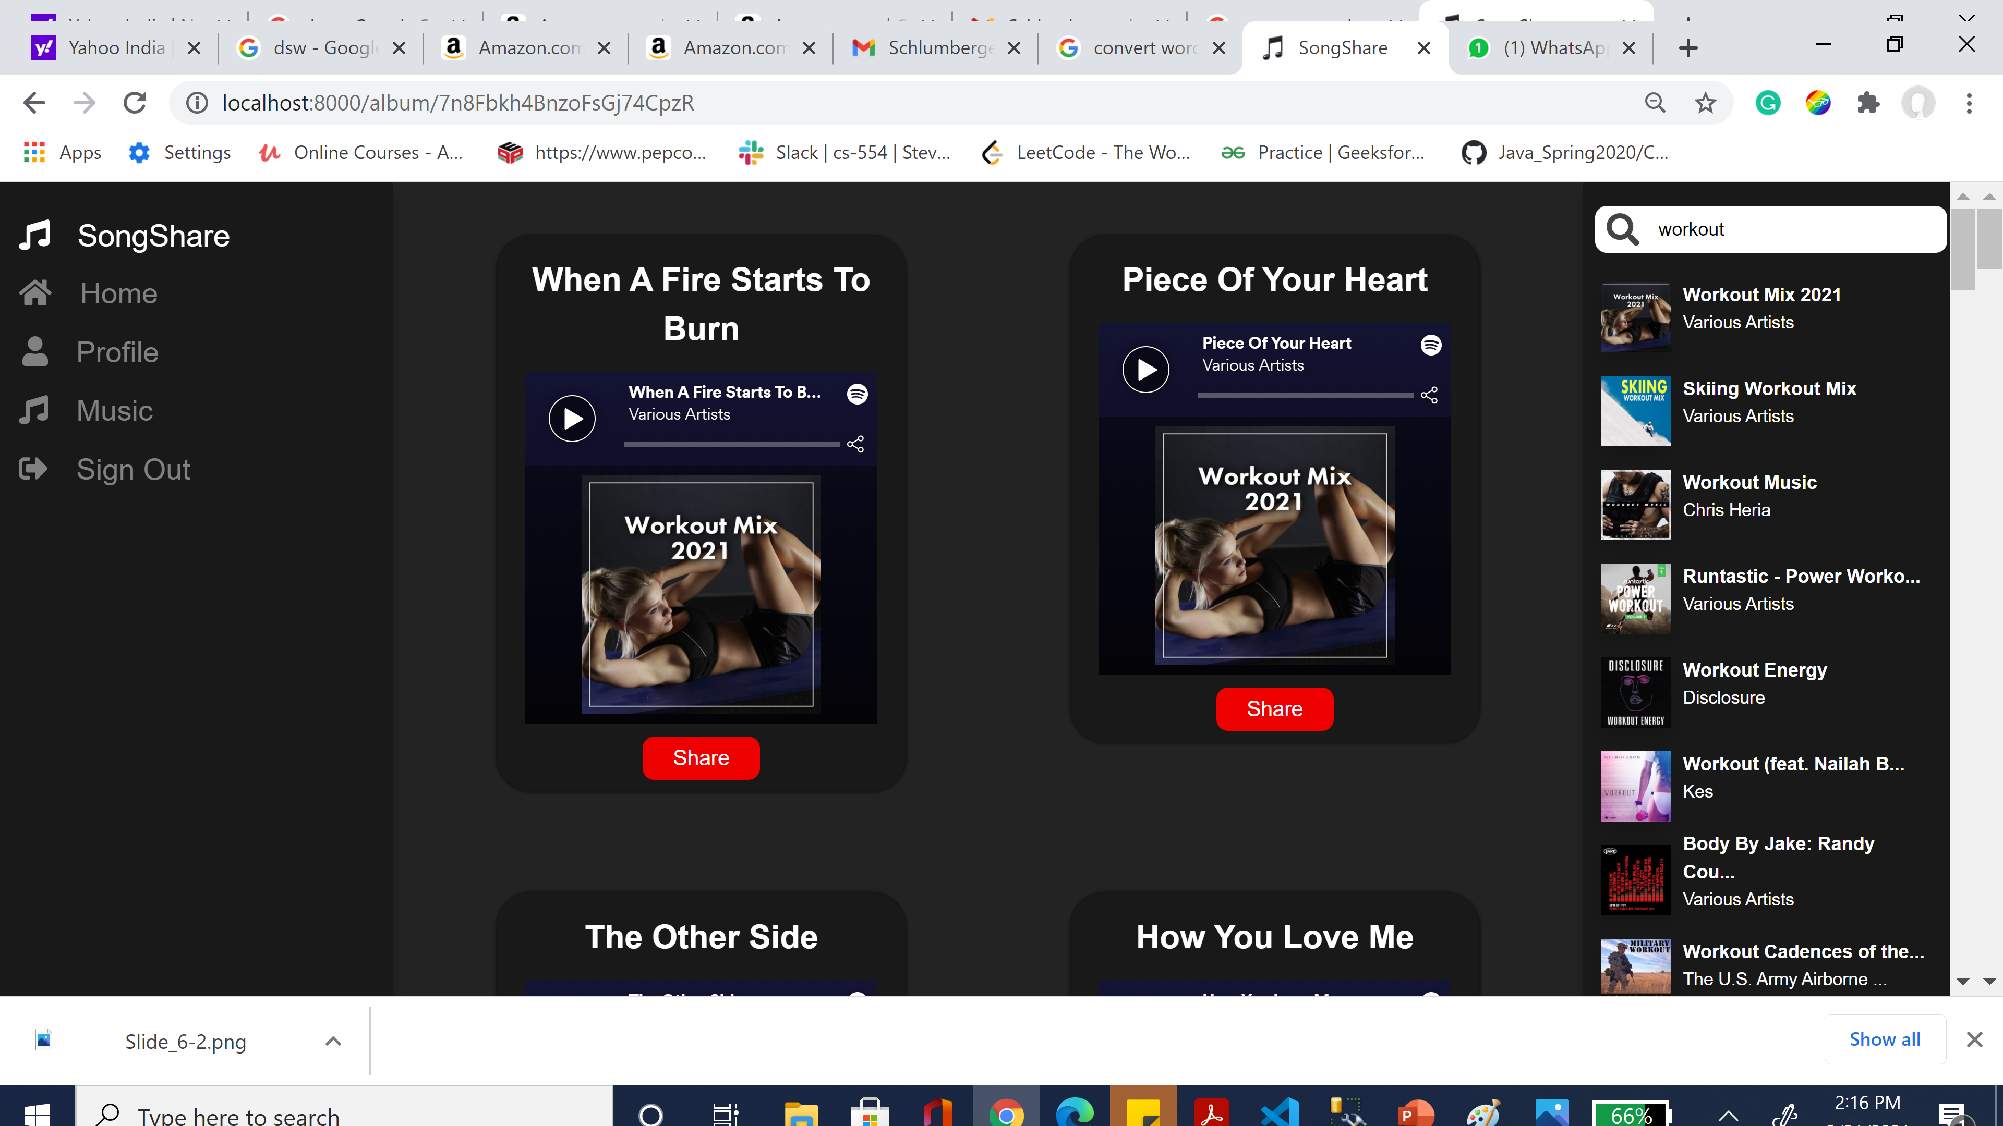
Spotify Twitter
Challenge 1: How to improve user experience by reducing time to call Spotify API’S on each request?
Redis is used to cache data provided from the Spotify API to reduce API calls and loading times on the website. Cached data includes: Artists, Albums, Tracks, and Search queries. Data such as playlist info is not cached since playlists are constantly updated by users and those changes should be reflected on the website.

Slide 10
Spotify Twitter
Conclusion: Improved performance after using Redis.
Challenge 2: How to overcome run time glitches (uncertainty of missing file and npm dependency) while running the application on different server?
Docker: Docker is portable, self-sufficient containers that can run on the cloud or on any other premises. These containers wrap-up the code and they are fully packed up with code, dependencies and configurations. It helps to provide required runtime environment to the application.
Conclusion: I submitted the application for final grades, and it ran successfully without any glitch.

Slide 11
Thank You!
Q&A?

